Slide 1
SECURE GROUP COMMUNICATION
Distributed Systems Project
Authors:
Brusamento Mattia
Ceruti Federico Maria
Donetti Gianmarco

Slide 2
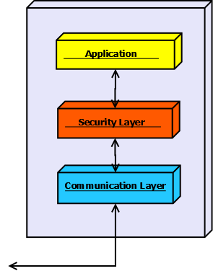
INTRODUCTION
We want to develop a system that can support secure group communication:
the server handles the management of the centralized key (DEK) and
the client intermediate keys (KEKs) using the Centralized Flat Table approach
the clients can connect and disconnect from the server, and exchange
messages in the group using symmetric encryption with the current DEK
that has been distributed by the server.
We will implement a “Communication Layer” in order to manage the exchange of messages in the group, with Multicast Sockets, and between each member and the server, with Sockets.
Since we need to manage the encryption/decryption of the messages
we will create a “Security Layer” that handles keys, encryption/decryption
and key-exchanges.

Slide 3
SECURITY
REQUIREMENTS for a Secure Group Communication:
Backward secrecy: no one can decrypt messages before joining
Forward secrecy: no one can decrypt messages after leaving.
PROBLEM: Symmetric encryption with a key for each pair of participants and public key encryption
require a lot of keys!
Possible SOLUTION: Symmetric encryption with a single shared key,
that has to be changed in order to guarantee the requirements.
DEK (Key Encryption Key) is unique, shared and used to encrypt messages.
KEKs (Key Encryption Keys) are distributed to members and used to encrypt DEK when needed.

Slide 4
Centralized Flat Table
Using a Centralized Flat Table is an approach to manage the DEK and the KEKs in an efficient way.
Scenario:
Each Group Member in the group is assigned an identifier, ID. ID is an n-bit binary number which is denoted
as X_{n-1}X_{n-2}...X₀, where X_{i} is either 0 or 1. The maximum size of the group N = 2^{n}.
The “Group controller” maintains 2*log(N) KEKs. That is for each bit position, there are two keys,
one for 0 and one for 1.
Each Group Member is given n + 1 keys. Half of the KEKs (i.e. n) which correspond to the n bits in its ID and K.
ID
BIT = 0
KEK 0,0 | KEK 1,0 | KEK 2,0
KEK 0,1 | KEK 1,1 | KEK 2,1
For example member with ID = 4 knows
KEKs 0,1 - 1,0 - 2,0
BIT = 1
Join: Let's assume that the ID of the joining Member is X_{n-1}X_{n-2}...X₀. In order to provide backward secrecy, we need to update
DEK and KEKs corresponding to this ID. New DEK and KEKs are encrypted with their old DEK and KEKs respectively and
broadcasted to the group.
Group Controller gives the new K and KEKs to the joining Member though a secure private communication channel.

Slide 5


JOINING: CHANGING DEK and KEKs
DEK
DEK’
DEK(DEK’)
Generate new keys
Encrypt them with old keys
For every
KEK
KEKs
KEKs’
KEKs(KEK’)
OLD MEMBERS
Here we should use a SECURE channel
New member receives the new keys and
doesn’t know about the old ones.
NEW MEMBER
They can decrypt the new keys
with their old ones

Slide 6
LEAVING THE GROUP
Let's assume that the ID of the leaving GM is X_{n-1}X_{n-2}...X₀. In order to provide to provide forward secrecy,
again DEK and the n KEKs held by the leaving GM are updated.
However, we need to use a different approach to update the keys since we cannot reuse the old keys to do the job.
The controller decides a new group key DEK' and encrypts with the remaining n keys that the leaving Member
does NOT possess and broadcasts the encrypted messages.
An existing group member can decrypt at least one of those messages and obtain the new group key K'.
Then the controller encrypts each new KEK corresponding to those of the leaving GM twice.
First with DEK' and then encrypts with the old KEK, and then broadcast to the group.
It make sure only the existing users can access new KEKs who already had old KEKs.
Notice that the leaving member cannot access since it does not have DEK' to remove one layer of encryption.

Slide 7
LEAVING: CREATING NEW DEK
Generate a new one
. Create new DEK’
. Encrypt DEK’ with EVERY OTHER old KEK and
send it to the remaining members.
DEK
DEK’
Encrypt with KEKs
ID
BIT = 0
KEK 0,0 | KEK 1,0 | KEK 2,0
KEK 0,1 | KEK 1,1 | KEK 2,1
Other members receive DEK’ encrypted
but each one has at least one valid key to
decrypt it, so can obtain the NEW DEK!
BIT = 1
KEK 0,0 (DEK’)
KEK 1,1 (DEK’)
KEK 2,1 (DEK’)
[Member with ID = 4 is leaving]
KEK (DEK’)
DEK’
DECRYPT

Slide 8
LEAVING: CHANGING KEKs
1. Create new KEKs
2. Encrypt every new KEK and send them.
KEK 0,0 | KEK 1,0 | KEK 2,0
KEK 0,1 | KEK 1,1 | KEK 2,1
Encrypt with the respective
OLD KEK [K 0,1 (K’ 0,1)]
KEK’
Encrypt with new DEK’
KEK 0,0 | KEK’ 1,0 | KEK’ 2,0
KEK’ 0,1 | KEK 1,1 | KEK 2,1
KEK’
Send new KEK
Now new KEKs have an encryption with two-layers:
the first level can be accessed by the members with the new DEK’ (the leaving member does not have it),
moreover the second level can be accessed only by the members with the old KEK, so every member can access
KEKs corresponding to its ID, as before.

Slide 9

COMMUNICATION
Since we have to manage quite complex operation, we need to define a protocol that allows the server and the members to coordinate. The main operations we need to standardize are:
Joining of a new member;
Leaving of a member.

Slide 10
PROTOCOL - JOINING
Let’s briefly describe the sequence of exchanged messages during a joining operation.
A new member sends a JOIN REQUEST to the server, which already contains his Public Key.
The server evaluates the request and either REFUSE it or starts the joining protocol sending a “SOMEONE IS JOINING” message to all the other members. This message already contains the new generated and encrypted keys.
The members on receiving this message, stop sending other messages, CHANGE their KEYS and ACKNOWLEDGMENT the server.
Upon receiving all the acknowledgments the server CONFIRM the update to all the members, the new one will also receive his keys encrypted with his public key. Now the communication can go on.

Slide 11
PROTOCOL - JOINING
SOMEONE JOINING
SOMEONE JOINING
SOMEONE JOINING
JOIN REQUEST

Slide 12
PROTOCOL - JOINING
ACK UPDATE
ACK UPDATE
ACK UPDATE

Slide 13
PROTOCOL - JOINING
UPDATE COMPLETE
UPDATE COMPLETE
UPDATE COMPLETE
JOIN ACCEPTED

Slide 14
PROTOCOL - LEAVING
Now we can speak about the protocol used when a member wants lo leave the group and the exchanged messages.
A member sends a LEAVE REQUEST to the server.
The server manages the request changing the keys and sends them to the other members in a “SOMEONE IS LEAVING” message.
Each member stops sending messaged, updates his keys and sends an ACKNOWLEDGEMENT to the server.
Upon receiving all the acknowledgments the server CONFIRMS the leaving operation to all the members and the communication goes on.

Slide 15
PROTOCOL - LEAVING
SOMEONE LEAVING
SOMEONE LEAVING
SOMEONE LEAVING
LEAVE REQUEST

Slide 16
PROTOCOL - LEAVING
ACK UPDATE
ACK UPDATE
ACK UPDATE

Slide 17
PROTOCOL - LEAVING
UPDATE COMPLETE
UPDATE COMPLETE
UPDATE COMPLETE
LEAVE ACCEPTED

Slide 18

SYNCHRONIZATION PROBLEMS
What if a member sends a message encrypted with a key that someone do not already have?? The new key can’t be used until the server confirms the update. [SOLVED BY THE PROTOCOL]
What if the keys change in the middle of a sending operation?? The receiver can’t decrypt the message because it is encrypted with an old key. Ideally we need to keep all the old keys. [UNSOLVABLE] Trade-off: keep the new key and the old one. [PARTIALLY SOLVED]

Slide 19
FLAT TABLE WEAKNESS
REQUEST MANAGER
The main problem of a system that uses an approach based on a Centralized Flat Table is managing multiple requests.
The protocol works fine until we manage single leaving or joining operations: we can’t manage simultaneous requests because of the changings in the keys.
SOLUTION:
The server keeps a synchronized queue that contains the various requests and manages them once per time.
QUEUE

Slide 20
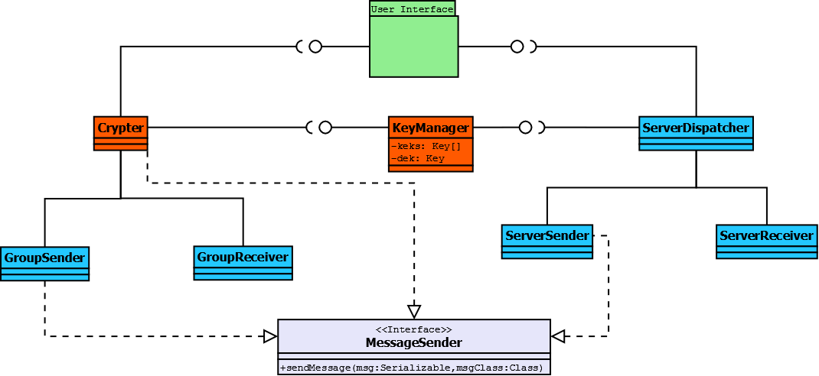
CLASS DIAGRAMS: CLIENT

Slide 21
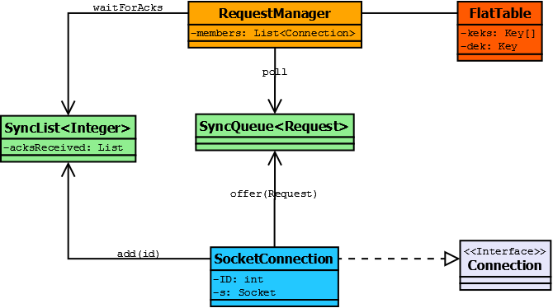
CLASS DIAGRAMS: SERVER

Slide 22
DEMO

